Slide 1
Build systems
Build automation is the process of automating the creation of a software build and the associated processes including:
compiling computer source code into binary code,
packaging binary code,
running automated tests.
https://www.slideshare.net/yandex/ss-42642539?qid=1c67a684-2636-43b6-bfe7-1371a1d49875&v=&b=&from_search=5

Slide 2
Without build automation
$ javac MyClass.java
Disadvantages:
difficult to work with large amount of files,
platform dependency,
absence of logical connections,
…

Slide 3
Shell-script
if test ! –e .nugget; then
mkdir .nugget
cp $cachedir /nugget.exe
fi
Advantages:
possibility to run a couple of commands,
provide primitive logical connections,
we can divide by stages: clean.sh, compile.sh, test.sh
Disadvantages:
platform dependency,
no single approach for every project.

Slide 4

make (1977)
$ cat Makefile
.PHONY: all clean install uninstall
all: hello
clean:
rm -rf hello *.o
main.o: main.c
gcc -c -o main.o main.c
hello.o: hello.c
gcc -c -o hello.o hello.c
hello: main.o hello.o
gcc -o hello main.o hello.o
install:
install ./hello /usr/local/bin
uninstall:
rm -rf /usr/local/bin/hello
$ make clean
$make

Slide 5
make (1977)
Advantages:
Single build process description
Disadvantages:
platform dependency,
no support of Java tasks, parameters, plugins.

Slide 6

Apache Ant (2000)
$ cat build.xml
<project>
<target name="clean">
<delete dir="build"/>
</target>
<target name="compile">
<mkdir dir="build/classes"/>
<javac srcdir="src" destdir="build/classes"/>
</target>
<target name="jar">
<mkdir dir="build/jar"/>
<jar destfile="build/jar/HelloWorld.jar" basedir="build/classes">
<manifest>
<attribute name="Main-Class" value="oata.HelloWorld"/>
</manifest>
</jar>
</target>
<target name="run">
<java jar="build/jar/HelloWorld.jar" fork="true"/>
</target>
</project>
$ ant compile jar run

Slide 7
Apache Ant (2000)
Advantages:
Support of Java-specific tasks
Platform independency
Extensible (plugins)
Able to build with parameters
Disadvantages:
No strict code versioning convention
No strict convention on code layout
No automatic dependency management (/lib folder)
Doesn't support JUnit4

Slide 8

Apache Ivy (2004)
$ cat ivy.xml
<ivy-module version=“1.0”>
<info organization=“ru.yandex.qatools.allure” module=“allure-testing-ant”/>
<dependencies>
<dependency org=“ru.yandex.qatools.allure“ name=“allure-testing-adaptor” rev=“1.4.0”/>
<dependency org=“org.aspectj“ name=“aspectjweaver” rev=“1.7.4”/>
</dependencies>
</ivy-module>
$ ant
Advantages:
+ Automatic dependency management

Slide 9

Apache Maven (2004)
$ cat pom.xml
<plugin>
<groupId>org.apache.maven.plugins</groupId>
<artifactId>maven-compiler-plugin</artifactId>
<version>3.0</version>
<configuration>
<source>${compiler.version}</source>
<target>${compiler.version}</target>
</configuration>
<plugin>
$ mvn clean compile

Slide 10
Apache Maven (2004)
Advantages:
Strict convention on code layout
Strict lifecycle: goals are predefined
Code sharing through remote repositories
Dependencies info stores in local repo
Code versioning rules
Multimodul projects support
Build description through Declarative approach

Slide 11

Gradle (2009)
$ cat build.gradle
repositories {
mavenCentral()
}
configurations {
agent
}
dependencies {
agent “org.aspectj:aspectjweaver:${aspectjVersion}”
testCompile “ru.yandex.qatools.allure:allure-testing-adaptor:${allureVersion}”
}
$ gradle clean compile

Slide 12
Gradle (2009)
Advantages:
Supports main Maven fetures
build.gradle file with domain-specific language (DSL) on Groovy
Incremental compilation support
Uses same remote repo as Maven
Able to emulate Maven behaviour
Supports plugins, which Maven does not

Slide 13

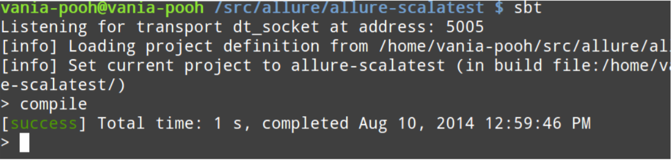
Scala build Tool SBT (2011)
$ cat build.sbt build.scala
version := “0.0.1”
scalaVersion := “2.10.3”
resolvers +=
“Sonatype OSS Snapshots” at https://oss.sonatype.org/content/repositories/snapshots
libratyDependencies ++= Seq(
“org.scalatest” % “scalatest_2.10” % “2.1.4” % “test”,
“ru.yandex.qatools.allure” % “allure-scalatest_2.10” % “1.4.0-SNAPSHOT” % “test”
)
testOptions in Test ++= Seq(
Tests.Argument(TestFrameworks.ScalaTest, “-oD”),
Tests.Argument(TestFrameworks.ScalaTest, “-C”, “ru.yandex.qatools.allure.scalatest.All
)

Slide 14
Scala build Tool SBT (2011)
Advantages (~Features):
Interactive console
Incremental code compilation
Plugins, which Maven does not support

Slide 15

Leiningen(2009)
Advantages (~Features):
project.cli written on Clojure
Support dependencies from Maven repos
Has alternative repo Clojars (http://clojars.org)

Slide 16
Build tools
for non-Java languages

Slide 17

Rake (Ruby)
Advantages (~Features):
description in Rakefile
uses dependencies management system - RubyGems

Slide 18

Grunt (Javascript)
Advantages (~Features):
description in Gruntfile.js
uses dependencies management system - Bower

Slide 19

Cabal (Haskell)
Advantages (~Features):
own repo Hackage
archives are in *.tar.gz format, not *.jar

Slide 20
Modern build automation system
The main goal is to automate actions with
code on the local machine of the developer
Automatic dependency management
Artifact Repositories
Clear life cycle
Versioning conventions
Source code location conventions

Slide 21
The advantages of build automation
A necessary precondition for continuous integration and continuous testing
Improve product quality
Accelerate the compile and link processing
Eliminate redundant tasks
Minimize "bad builds"
Eliminate dependencies on key personnel
Have history of builds and releases in order to investigate issues
Save time and money - because of the reasons listed above.

